Slide 1
KC Network Programmability
Beyond Your First Playbook

Slide 2





$ Whoami
Patrick Kuny
System Engineer on Cerner’s DeviceWorks Technology Architecture Team
Apprentice with Fedora Project’s Infrastructure Team
Linux Systems Administrator for the National Speleological Society
pmkuny

Slide 3
Configuration Management
Configuration Management:
Describes a system’s end state
Describes how a system should look, not how it gets there
Abstraction of lower-level tools
Universally-understood languages
Infrastructure as Code
Ansible
Chef
Puppet
SaltStack

Slide 4
Ansible
“Agentless”
Talks to network devices
Community Support and Vendor Support
Support for various platforms (Juniper, Cisco IOS, F5)

Slide 5
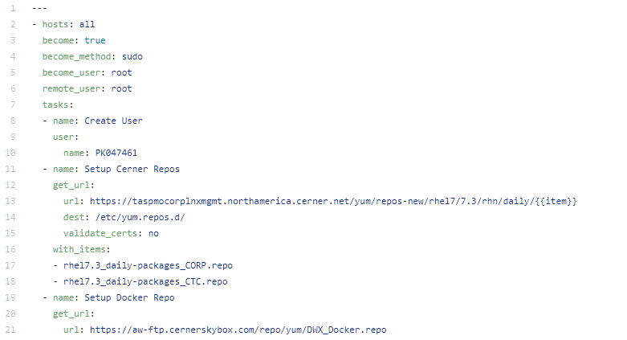
playbooks
Playbooks are groups of “plays” which describe hosts, tasks, variables, and roles.
Ex: ansible_oneshot_workstation
https://path.to.repo/{{item}}
rhel_7.3_packages1.repo
rhel_7.3_packages2.repo
https://path.to.docker.repo

Slide 6
inventories
Inventories define groups of nodes
Group name can be used to identify
Specific inventories can be used for specific playbooks to run against.
Doesn’t have to follow “logical” groupings (e.g. uncommon names)
[dns]
ns1.domain.com
ns2.domain.com
someserver.domain.com
[web]
web1.domain.com
web2.domain.com
[backups]
bk1-push.domain.com
bk2.domain.com
[infra]
web1.domain.com
ns1.domain.com

Slide 7
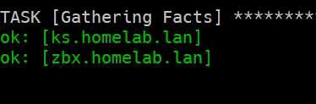
gathering facts
Fact-Gathering used to determine node state
Populates variables that can be used later
Can be forced to refresh node state

Slide 8
variables
Generally contained within a vars/ directory in role
Can be referenced using double brackets {{ my_variable }}
Helpful for referencing in Jinja2 templates
Can be included in the task level by include_vars

Slide 9
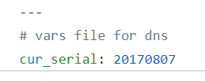
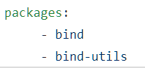
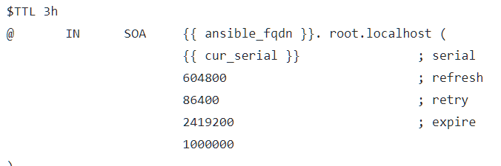
Variables Example
/roles/nameserver/vars:
main.yml packages.yml
Facts-Gathered Variable
User-Defined Variable

Slide 10
Roles
Roles are sets of tasks, variables, and settings that can be applied to specific inventory entries.
Ex: nameserver role installs BIND
Mixing roles for dependent assignments: common role has sysadmin tools, nameserver role has bind
Roles are a great way to create structure and organize assignment within your project.
Inventory
[dns]
ns1.domain.com
ns2.domain.com
someserver.domain.com
Role
hosts: dns
roles:
common
nameserver
Assignment
ns1.domain.com = common AND nameserver
ns2.domain.com = common AND nameserver
someserver.* = common AND nameserver
+
=

Slide 11
Tags
Tags can be applied at the play level, role level, or task level
Limit certain actions to specific tagging
ansible-playbook --tags $tag
Specify multiple tags

Slide 12
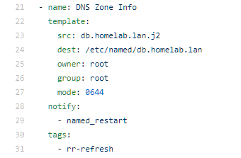
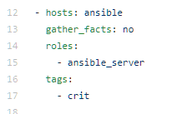
Tags example
ansible -i hosts ns1.homelab.lan –m systemd –a “name=named state=restarted”
ansible-playbook –i hosts --tags rr-refresh site.yml
Task Level
Play Level

Slide 13
Ansible galaxy
https://galaxy.ansible.com
Allows user-created roles and modules to be imported for use.
Has tie-ins for issue tracking, Github, build status

Slide 14
Ex1. Maintaining State
Goals:
Common Role to All Hosts
Role-specific hosts maintained
Automate Ansible Deployment via Ansible Control Host (ACH)
Key-based authentication for deployments
All updates and control through ACH direction
ACH controls itself

Slide 15
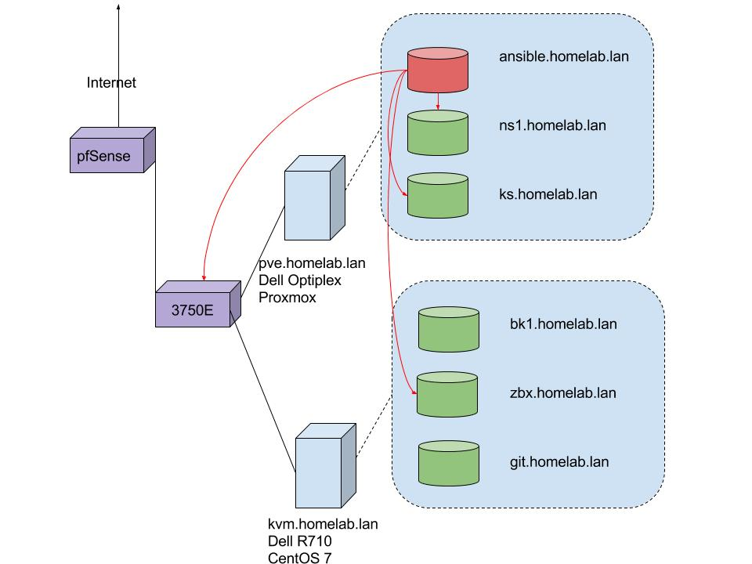
Maintaining State (Cont)

Slide 16
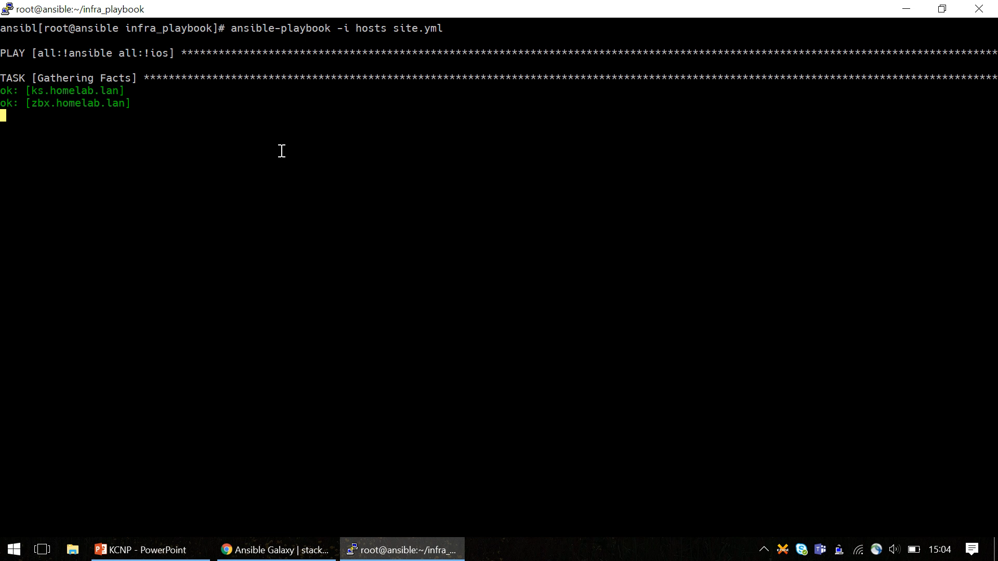

Slide 17
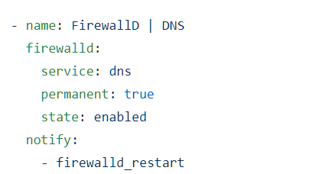
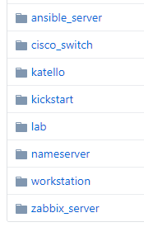
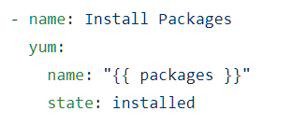
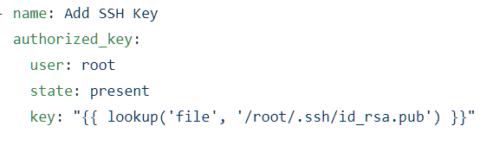
Maintaining State (Cont)
Role-Specific – Handling Firewalls
Roles
Common Tasks – Installing Packages
Common Tasks – Handling SSH Keys

Slide 18
ex2. Docker containers
Take traditional script-based and manual deployment process and automate it
Easy-to-use, oneshot playbook

Slide 19
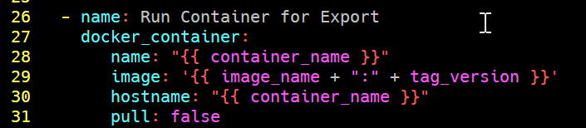
ex2. Docker containers
Specify Build Vars
Use script to fire a docker build command.
Export Running Container
Destroy Container
Specify build vars
Run ansible-playbook site.yml
docker run –itd registry.access.redhat.com/rhel7.3:7.3-66 && docker build . && docker export test –o test.build

